Slide 1
Introduction to Information Systems
Information System Management
Course No: 0612-301
Bokhtiar Adil Prottoy
Lecturer, CSE
DIU

Slide 2
System Concept
A system –
A way of thinking about organizations and their problems.
Involves a set of techniques that helps in solving problems.
An organized relationship among functioning units.
An orderly grouping of individual components linked together to achieve specific objective/s.
Each component is part of the total system and has to do its share of work for the system to achieve the intended goal.
Components may refer to physical parts, managerial steps, etc.
Notes:
A university is a system because it has several interconnected parts—such as the administration, HR, accounts, IT, and academic departments. Each part performs its own function, but all work together to achieve a common goal: providing quality education to students.

Slide 3
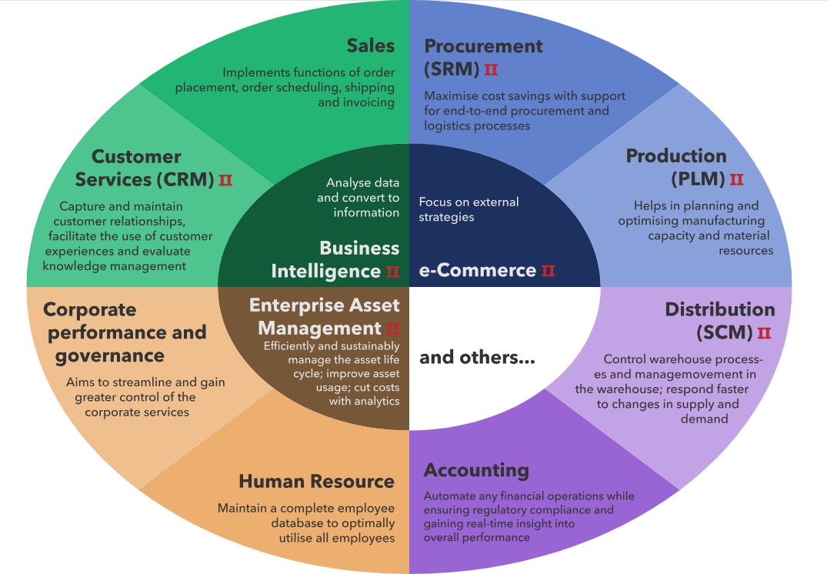
System Concept
Notes:
Amazon is a big system made up of many smaller subsystems that all work together:
Sales System: When a customer places an order, the sales system records it and schedules shipping.
Procurement (SRM): Amazon buys products from suppliers and manages stock in warehouses.
Production (PLM): For Amazon’s own products (like Echo or Kindle), this system helps plan manufacturing.
Distribution (SCM): Manages warehouses and delivery, ensuring items reach customers on time.
Customer Service (CRM): Handles customer complaints, returns, and feedback.
Human Resource: Manages employee information, training, and salaries.
Accounting: Tracks payments, refunds, and financial reports.
Business Intelligence: Analyzes customer data to recommend products or improve services.
All these subsystems share information. For example, when you buy a laptop:
The sales system confirms your order,
The warehouse (distribution) prepares the product,
The accounting system processes payment,
And customer service tracks your delivery.

Slide 4
System Concept
Therefore, The study of systems concepts has three basic implications –
A system must be designed to achieve a predetermined objective
Interrelationships and interdependence must exist among the components.
The objectives of the organization as a whole have a higher priority than the objectives of its subsystems.
Notes:
A system is goal-oriented: Every system is created to achieve a specific purpose. For example, a university’s system is designed to provide quality education.
All parts are connected and depend on each other: Each department or unit in a system must work together. For instance, in a hospital, the doctors, nurses, and billing department depend on each other to serve patients effectively.
The overall goal is more important than individual goals:
The main objective of the whole organization comes first. For example, in a university, if the HR department recruits fewer teachers than actually needed to reduce salary costs, it may lower the overall education quality. Therefore, the university’s main goal of providing quality education should come before departmental cost-saving goals.

Slide 5
Characteristics of a System
Characteristics of a system
Organization
Interaction
Interdependence
Integrations
Central objective
Notes:
1. Organization
A system has organized parts or components arranged in a specific order to achieve a goal. Each part has a role and works according to a plan.
Example: In a university, departments like CSE, EEE, and BBA are organized under different faculties, but all follow the university’s structure to maintain smooth operations.
2. Interaction
All components of a system interact with each other to exchange information or resources. These interactions help the system work as a whole.
Example: When a student pays tuition fees, the finance system updates the record, and the academic system allows the student to register for courses.
Interdependence
Each part of a system depends on other parts. If one part fails, it can affect the entire system.
Example: In a software company, the testing team depends on the development team to deliver the code. If developers delay, testers cannot perform their work on time.
Integration
Integration means combining all parts so they work together as a single unit. It ensures the output of one part becomes useful input for another.
Example: In a business, the sales system is integrated with the inventory system — when a product is sold, the stock level is automatically updated.

Slide 6
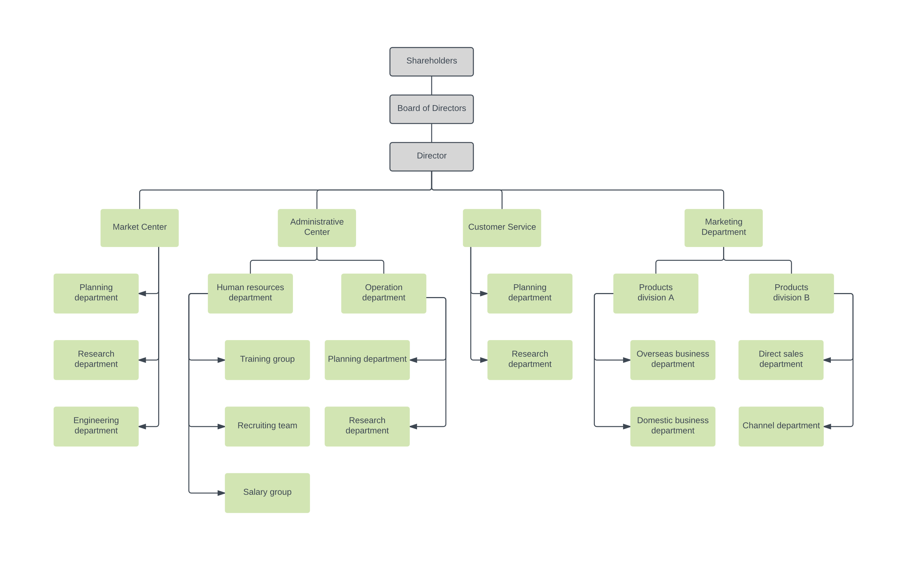
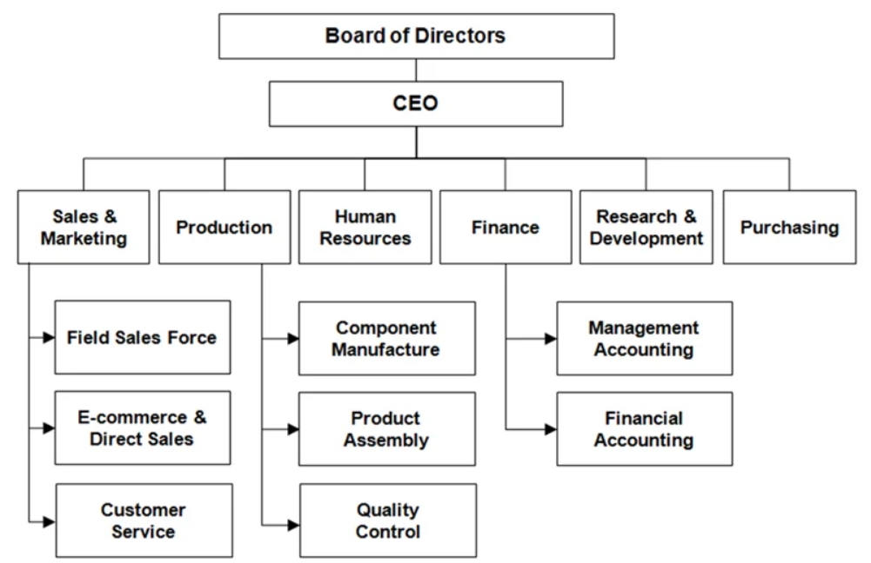
Characteristics of a System
Organization
Implies structure and order.
The arrangement of components that helps to achieve objectives.

Slide 7
Characteristics of a System
Interaction
How each component functions with other components.
Communication and exchange of information, energy, or resources between the components of a system.
Essential for coordination and functionality.
Interdependence
Dependence of each subsystem or component on others.
Certain subsystem may need the outputs of other subsystem as input.
Ensures the contribution of each subsystem to achieve the system objectives.

Slide 8
Characteristics of a System
Integration
Concerned with how a system is tied together.
The harmonious functioning of all components as a unified whole.
All the parts of the system need to work in sync even if their jobs are unique.
Proper integration maximizes the system's output and effectiveness.
Central Objective
Guides the functioning and alignment of all components.
It can be real or stated.
A company might state that its primary objective is to "serve customers," but in reality, its operations might prioritize maximizing profit.

Slide 9
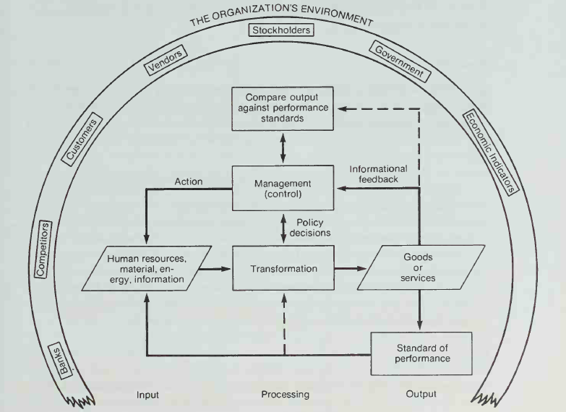
Elements of a System
Inputs and outputs
Processors
Control
Feedback
Environment
Boundaries and interface

Slide 10
Elements of a System
Inputs and outputs
A system’s main objective is to produce an output that meets the expectations of its intended users.
Inputs are processed by the system to generate the desired output.
Determining the output is the first step in defining the required input and processing design, as seen in systems analysis.
Processors
Involves the actual transformation of input into output.
It is the operational component of a system.
Notes:
Inputs:
Client requirements: business goals, technical specs, deadlines, and budget.
Human resources: developers, designers, managers.
Technology: programming tools, servers, frameworks, APIs.
Capital: money for salaries, tools, licenses, office setup.
Outputs:
Working software products (web apps, mobile apps, dashboards).
Documentation, reports, and client support.
Client satisfaction, company reputation, and profit.
←----------------------------------------------→
Processors
The development teams design, code, and test software.
Project managers coordinate schedules and milestones.
DevOps handles deployment and server setup.
QA testers verify quality and performance.

Slide 11
Elements of a System
Control
A decision-making subsystem.
Governs the input, processing, and output of a system to ensure its balance.
Feedback
Control in a dynamic system is achieved through feedback.
Measures output against standards and may lead to changes in input, processing, or output.
Can be positive or negative.
Vital to identify issues, justify changes, and improve performance.
Notes:
Control keeps the system running smoothly — it’s the management and governance layer.
In this company:
Project management tools (like Jira or Trello) track progress and deadlines.
Policies and procedures define coding standards, testing protocols, and review steps.
Finance department controls budgets and billing cycles.
Team leads monitor productivity and resource use.
←---------------------------------------------------------------------------------------------------------→
Feedback is how the system evaluates its performance and improves.
Examples in the company:
Client feedback after delivery (bug reports, satisfaction ratings).
Employee feedback during retrospectives (what went well, what didn’t).
Performance metrics — delivery time, code quality, customer retention.
Error tracking tools — showing real-time production issues.

Slide 12
Elements of a System
Environment
The external elements that impacts the system.
Often determines how a system must function.
Boundaries and Interface
A system’s boundaries determines its scope and interface with other systems.
Boundaries help identify what a system includes and excludes.
Notes:
The environment is everything outside the company that influences how it operates.
Market demand: clients shifting from websites to AI-based systems.
Competition: other firms offering lower prices or faster delivery.
Technology trends: new frameworks or cloud services.
Regulations: data protection laws (like GDPR).
Economic conditions: inflation, exchange rates, investor funding.
←----------------------------------------------------------------------------------------------→
Boundaries:
Define what belongs to the company system and what doesn’t. For example, the company handles software development — not hardware manufacturing or marketing for clients.
←---------------------------------------------------------------------------------------------→
An interface is basically a connection point - where two systems meet and interact.
Interface with Clients.
Clients send project requirements through emails, Zoom calls, or a client portal.
The company sends back quotations, progress updates, and final deliverables.
Interface with Vendors
The company might use AWS (cloud provider) or PayPal (payment gateway).
Interface with Employees
The login page, dashboard, and time-tracking tools are the interface between workers and the company’s internal systems.

Slide 13
Types of Systems
Physical systems
Static or dynamic
Abstract systems
Conceptual models to point out the significant components and relationships.
Open and closed systems
Based on the system’s degree of independence.
Information systems
Notes:
A physical system is something you can touch or see. It has tangible components — machines, devices, networks, servers, or people.
In a software company:
The company’s hardware infrastructure — servers, routers, employee laptops, biometric machines — all form part of a physical system.
Even the office building itself (with power supply, air conditioning, and security systems) is part of it.
Static SystemStudent Admission Record SystemFixed structure, updated occasionally
Dynamic SystemLearning Management System (LMS)Constantly updated with new data and activities
←--------------------------------------------------------------------------------------------------→
Open System:
It interacts, exchanges data, and adapts based on outside feedback.
It’s flexible and connected.
Closed System:
It operates with little or no interaction with the outside world.
It’s self-contained and independent.
←---------------------------------------------------→
Information systems turn data into useful information that guides action.

Slide 14
Open Systems
Has many interfaces with its environment.
Permits interaction across its boundary to exchange inputs and outputs.
Five important characteristics –
Input from outside
Self-adjusting and self-regulating to achieve steady state i.e. equilibrium.
Entropy
To get to steady state and not to run down over time.
Process, output, and cycles
Follows a continuous flow path.
Differentiation
Greater specialization and interaction to increase value.
Equifinality
Goals are achieved through a variety of paths.
Notes:
University as an Open System:
A university doesn’t exist in isolation — it constantly interacts with its environment: students, parents, industries, government, and society.
1. Input from Outside
The university receives:
Students (as human input)
Funds (from government, donors, or tuition)
Information (societal needs, job market trends)
Resources (teachers, lab equipment, materials)
Self-Adjusting and Self-Regulating:
If enrollment drops, the university might introduce new programs (like Data Science or AI) to attract students. If job trends change, it updates its syllabus to match market demand.
Entropy:
“Entropy” here means the natural tendency of any system to break down or lose effectiveness if it doesn’t adapt.
If the university stops updating its curriculum or ignores industry changes, students will stop enrolling, and its quality will decay.

Slide 15
Information Systems
Information system –
a set of interrelated components
that collect (or retrieve), process, store, and distribute information
to support decision making and control in an organization
Data are streams of raw facts representing events in the organizations and the environment.
Information means data that have been shaped into a form that is meaningful and useful to human beings.

Slide 16
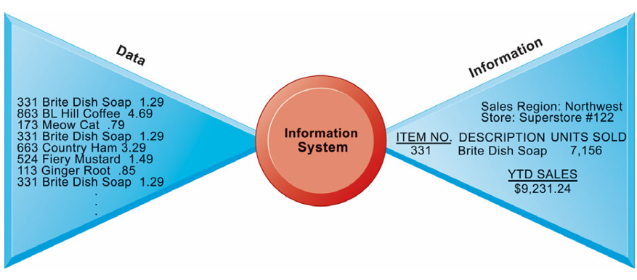
Information Systems
Raw data of a supermarket are being processed to extract useful information

Slide 17
Information Systems
The activities/functions/elements of information systems –
Environment
The external factors that impact and shape the system
Inputs
Captures or collects raw data from within the organization or from its external environment
Processing
Converts this raw input into a meaningful form
Outputs
Transfers the processed information to wherever it will be used
Feedback
Output that is returned to appropriate members of the organization to help them evaluate or correct the input stage
Notes:
An information system works like a cycle — it takes in data, processes it, produces results, and then uses feedback to improve. It has five main parts:
Environment – Things outside the system that affect it.
Inputs – Raw data collected from inside or outside the organization.
Processing – The system changes that raw data into something meaningful.
Outputs – The useful information that comes out and gets shared or used.
Feedback – Information sent back to improve or correct future actions.

Slide 18
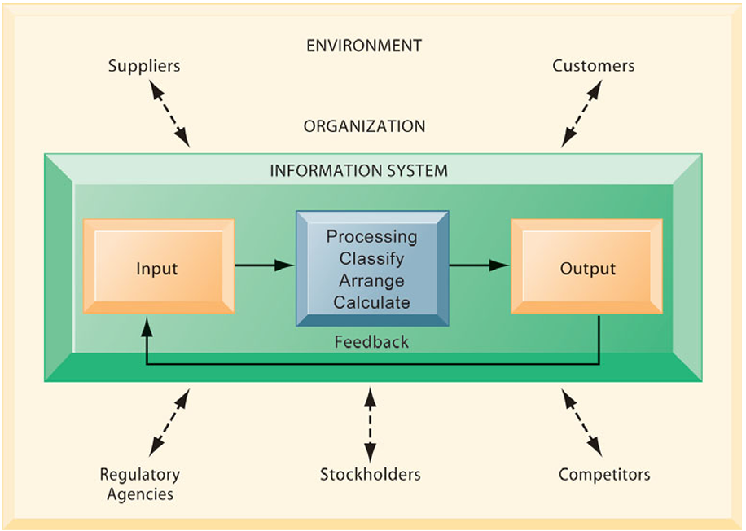
Information Systems

Slide 19
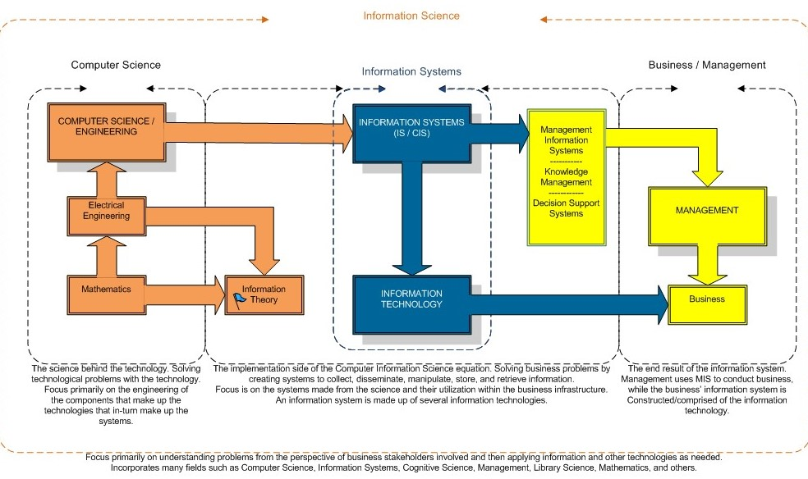
Information Systems

Slide 20
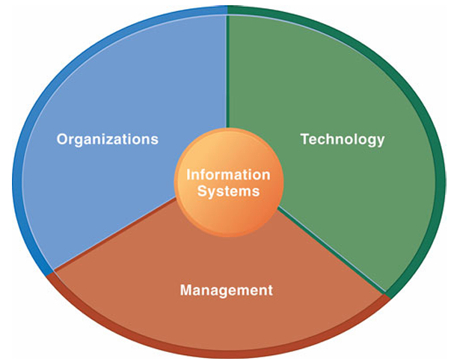
Dimensions of Information Systems
Computers and softwares are not the only part of an information system.
The dimensions of information system –
Organizations
Management
Information technology
They address –
The problems they are designed to solve
Their architectural and design elements
The organizational processes that lead to these solutions

Slide 21
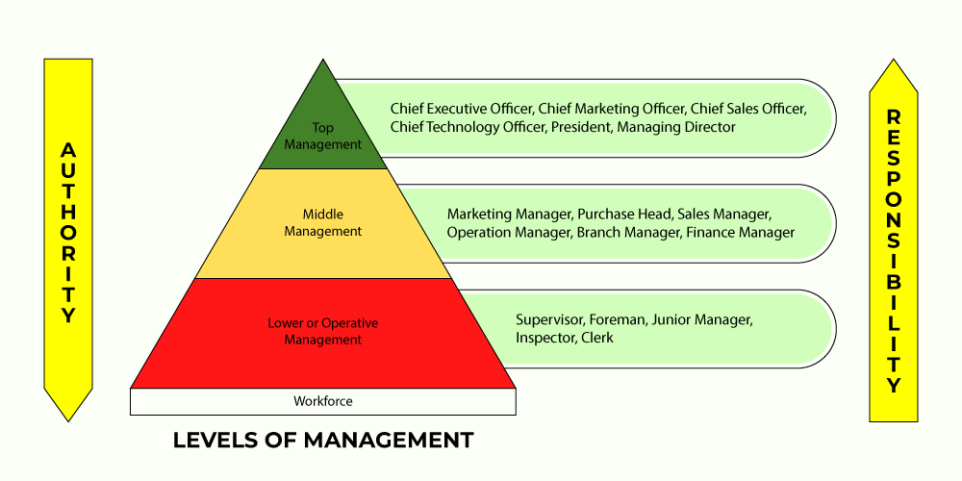
Organizations

Slide 22
Organizations
Top level management
Formulates objectives, plans, and policies.
Makes long-range strategic decisions.
Coordinates and control of the performance.
Analyses of the business environment.
Sets up an organizational framework.
Assembles of the resources.
Ensures financial performance of the firm.
Requires summarized information from a variety of sources to attain goals.
Relatively open, dynamic, and adaptive.
Decisions are mostly judgmental.

Slide 23
Organizations
Middle management
Carries out the programs and plans of senior management.
Interprets of the policies framed by the Top Level Management.
Selects of suitable operative and supervisory personnel.
Assigns of duties and responsibilities to the Lower Level Management.
Motivates employees to get desired objectives.
Cooperates with the entire organization.

Slide 24
Organizations
Lower management
Also known as Supervisory or Operational Level Management.
Issues of orders and instructions.
Makes day-to-day, relatively structured control decisions.
Monitors the daily activities of the business.
Assigns and assists the workers
Represents workers’ grievances.
Ensures a safe and proper work environment.
Helps the middle level management.
Encourages initiative of employees.
Needs detailed internal information.

Slide 25
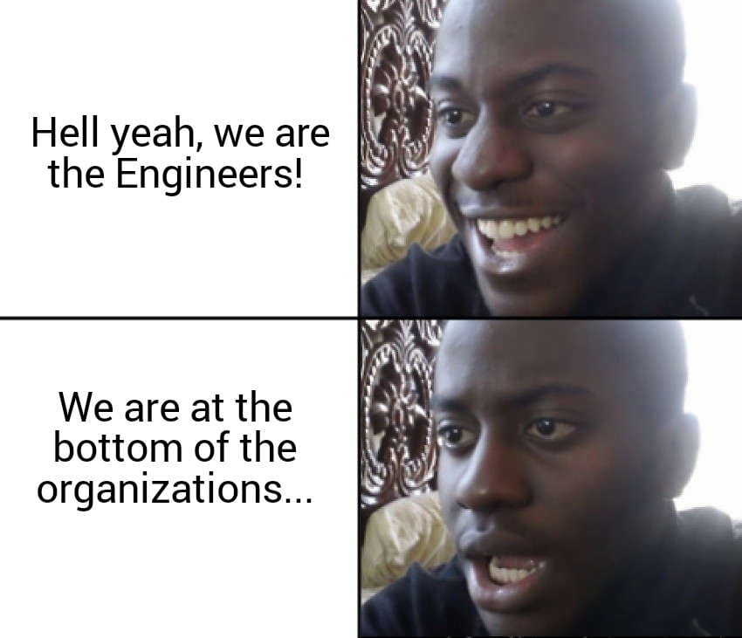
Organizations
Workforces include –
Data workers
Clerks, secretariats, etc.
Knowledge workers
Engineers (😔), scientists, architects, etc.
Production workers
Service workers
And, many others

Slide 26
Organizations
Business functions
Sales, marketing, manufacturing, production, finance, accounting, HR, etc.
Formal rules
Informal work practices
Automation
Differing perspectives, conflicts, compromises, and agreements.
Unique culture
Fundamental set of assumptions, values, and ways of doing things.
Accepted by most of its members.
Notes:
Business Functions:
1. Sales & Marketing
Promotes the organization, attracts clients or students
2. Manufacturing / Production
Produces the main output
3. Finance & Accounting
Handles money — salaries, budgets, expenses
4. Human Resources (HR)
Manages hiring, training, employee well-being
Formal Rules: Official policies, regulations, and procedures that guide how work should be done.
Informal Work Practices:The unwritten ways people actually get things done. University: teachers sharing resources privately or adjusting class times for convenience.
Software Company: developers using informal Slack channels to solve problems faster than formal meetings.
Differing Perspectives, Conflicts, Compromises, and Agreements:
Different departments or people have different goals — and that creates tension. To keep the system working, organizations need communication and compromise.
University: faculty want flexible schedules, but administration wants strict timelines.
Software Company: developers want more time for quality, while clients push for faster delivery.
Unique Culture : University: a culture of academic freedom, respect for hierarchy, and intellectual debate.

Slide 27
Dimensions of Information Systems
Management
Manage what already exists.
Create new products and services.
If needed, re-create the organization.
Information Technology Infrastructures
Provides the foundation, or platform, on which the firm can build its IS.
Hardware and software.
Data management technology.
Networking and telecommunications technology.

Slide 28
Information Systems
Information system enables the firm to –
increase its revenue or decrease its costs
by providing information
that helps managers make better decisions
that improves the execution of business processes
The decision to invest in any new information system is determined by the extent to which the system will lead to –
better management decisions
more efficient business processes
higher firm profitability

Slide 29
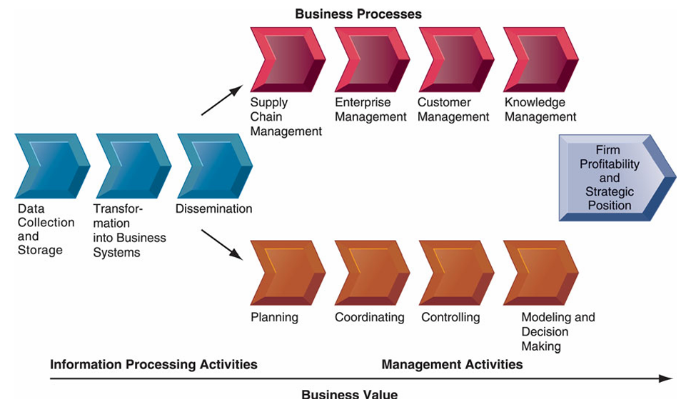
Information Value Chain
Notes:
Information Value Chain: explains how raw data is transformed into valuable information that supports business decisions and strategic goals. It shows the step-by-step process through which data gains value as it moves through different stages of an organization’s information system.
Stages of the Information Value Chain
Data Collection and Storage
Raw data is gathered from various sources (e.g., transactions, sensors, surveys).
This data is stored in databases or information systems for further use.
Transformation into Business Systems
The collected data is processed and organized into useful business information.
For example, converting sales data into reports, summaries, or performance metrics.
Dissemination
The processed information is shared with relevant departments or users who need it.
Information flows through the organization for decision-making and planning.
2.1. Use in Management Activities
Once information is available, it supports management functions such as:
Planning – setting goals and strategies using reliable data.
Coordinating – ensuring departments work together based on shared information.
Controlling – monitoring performance and correcting deviations.
Modeling and Decision Making – using data models or analytics to choose the best business actions.
2.2 Business Process.
Supply chain management Managing the flow of materials, products, and information from suppliers to customers.
Enterprise Management (EM)
Coordinating all departments and resources to achieve the organization’s goals.
Customer Management (CM)
Maintaining good relationships with customers or service users by understanding and meeting their needs.
Knowledge Management (KM)
Collecting, organizing, and sharing knowledge within the organization to improve learning and performance.
business processes and management activities usually work parallelly and support each other.
Business processes (like supply chain, customer, or knowledge management) focus on day-to-day operations — how work actually gets done.
Management activities (like planning, controlling, decision-making) focus on guiding and improving those operations.

Slide 30
Complementary Assets
Investing in information technology does not by itself guarantee good returns.
They must be accompanied by complementary assets.
Complementary assets are those assets required to derive value from a primary investment.
They are the supportive values, structures, behavior patterns, etc. in the organization.
Notes:
Complementary assets are the supporting factors that help an organization get the full benefit from its investment in information technology.

Slide 31
Complementary Assets
Strong management support – leadership that knows how to use IT strategically.
Skilled employees – who can operate new systems and adapt to technological changes.
Efficient business processes – workflows that fit with the new system.
Organizational culture – encourages innovation, sharing, and continuous improvement.
Proper legal and social environment – laws, policies, and market conditions that favor IT adoption.

Slide 32
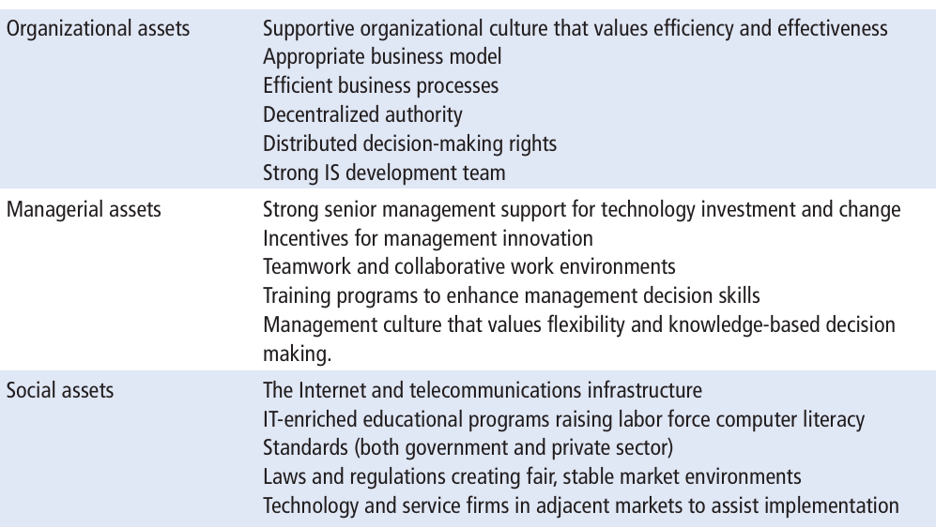
Complementary Assets

Slide 33
Study on Information Systems
The study of information systems and their development is a multi disciplinary subject.
It addresses the range of strategic, managerial and operational activities involved in the gathering, processing, storing, distributing and use of information, and its associated technologies, in society and organizations.
It examines more than just the technological system, or just the social system. It investigates the phenomena that emerge when the two interact.

Slide 34
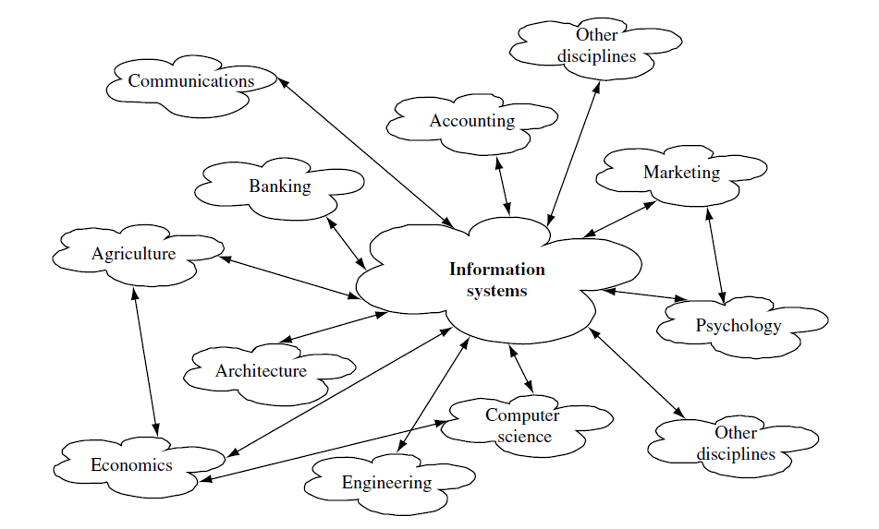
Study on Information Systems

Slide 35
Study on Information Systems
Also, there are many categories of information systems –
Artificial intelligence system
Computing platform
Data warehouses
Decision support system
Enterprise resource planning
Enterprise systems
Expert systems
Global information system
Multimedia information system
Office automation
Process control system
Search engines
Social information systems
Geographic information system

Slide 36
The END

